Slide 1


Grocery Store's Data MRA Project-Milestone 2
BY: Ayush Agarwal

Slide 2
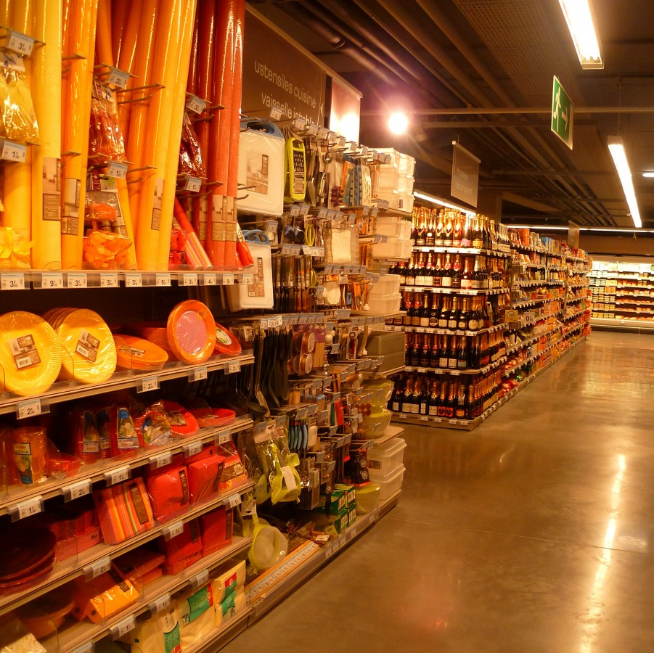
Contents:
Executive Summary of the data
Exploratory Analysis & Insights
Market Basket Analysis
Associations Identified
Recommendation

Slide 3
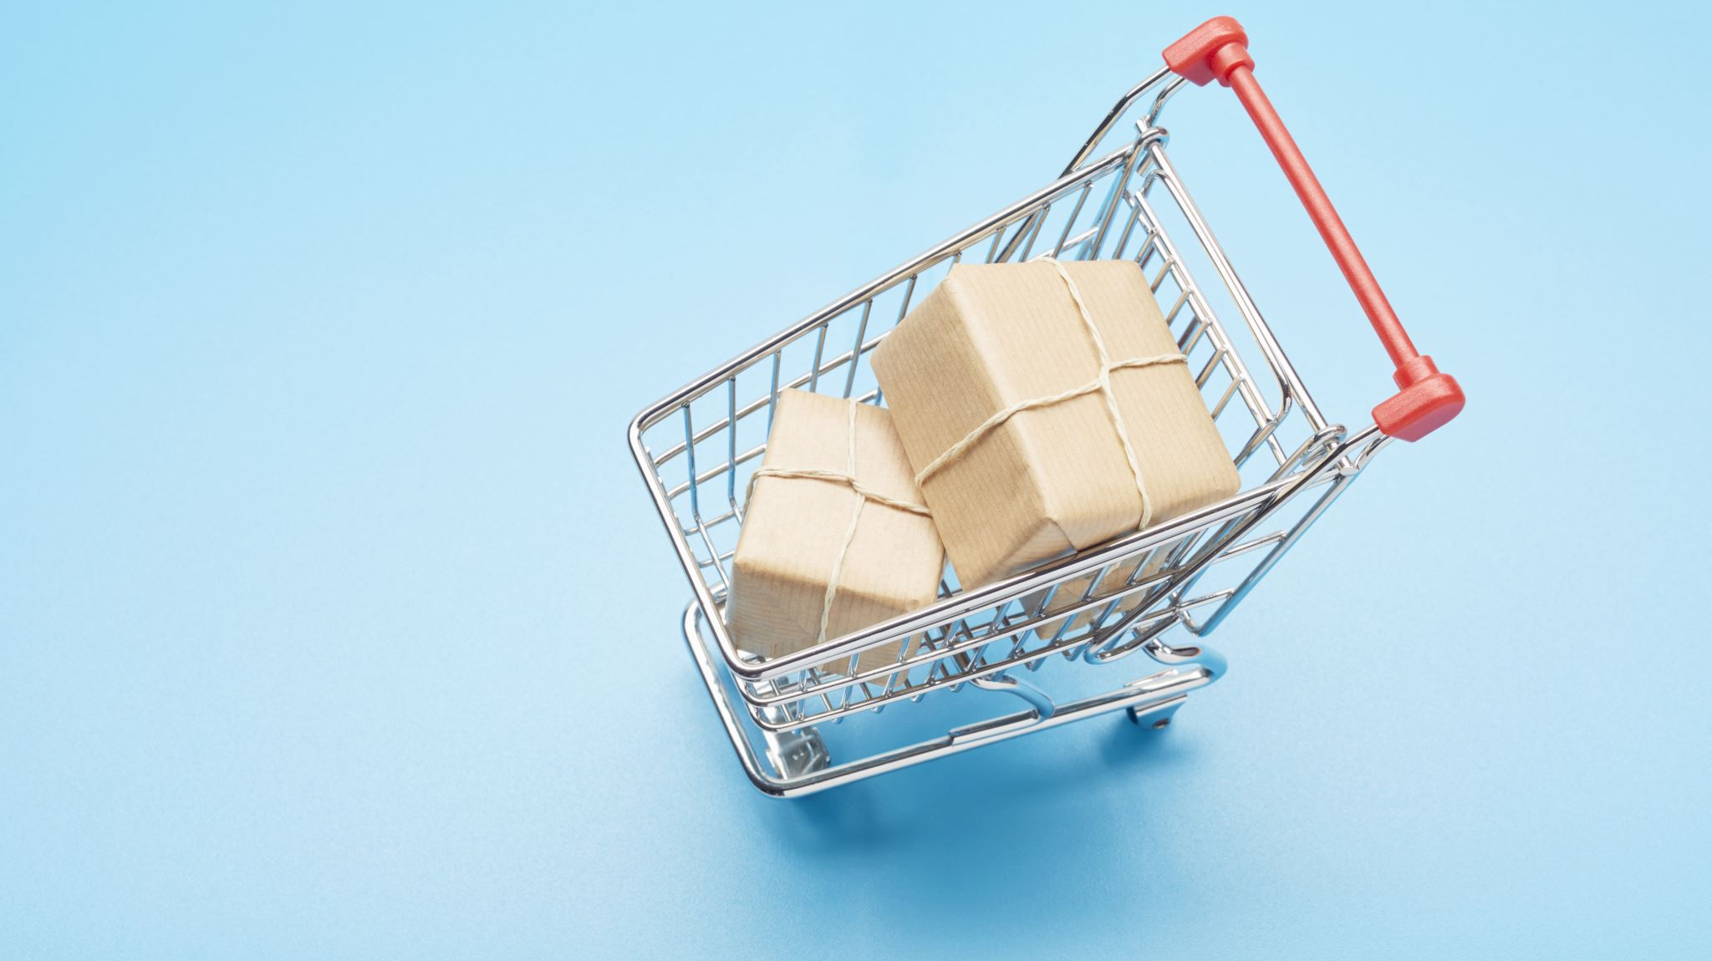
Agenda:
Executive Summary of the data
Exploratory Data Analysis
Market Basket Analysis
Associations Identified
Recommendation

Slide 4

01 Executive Summary
Problem statement
Executive Summary & Data Dictionary
Assumptions about data

Slide 5
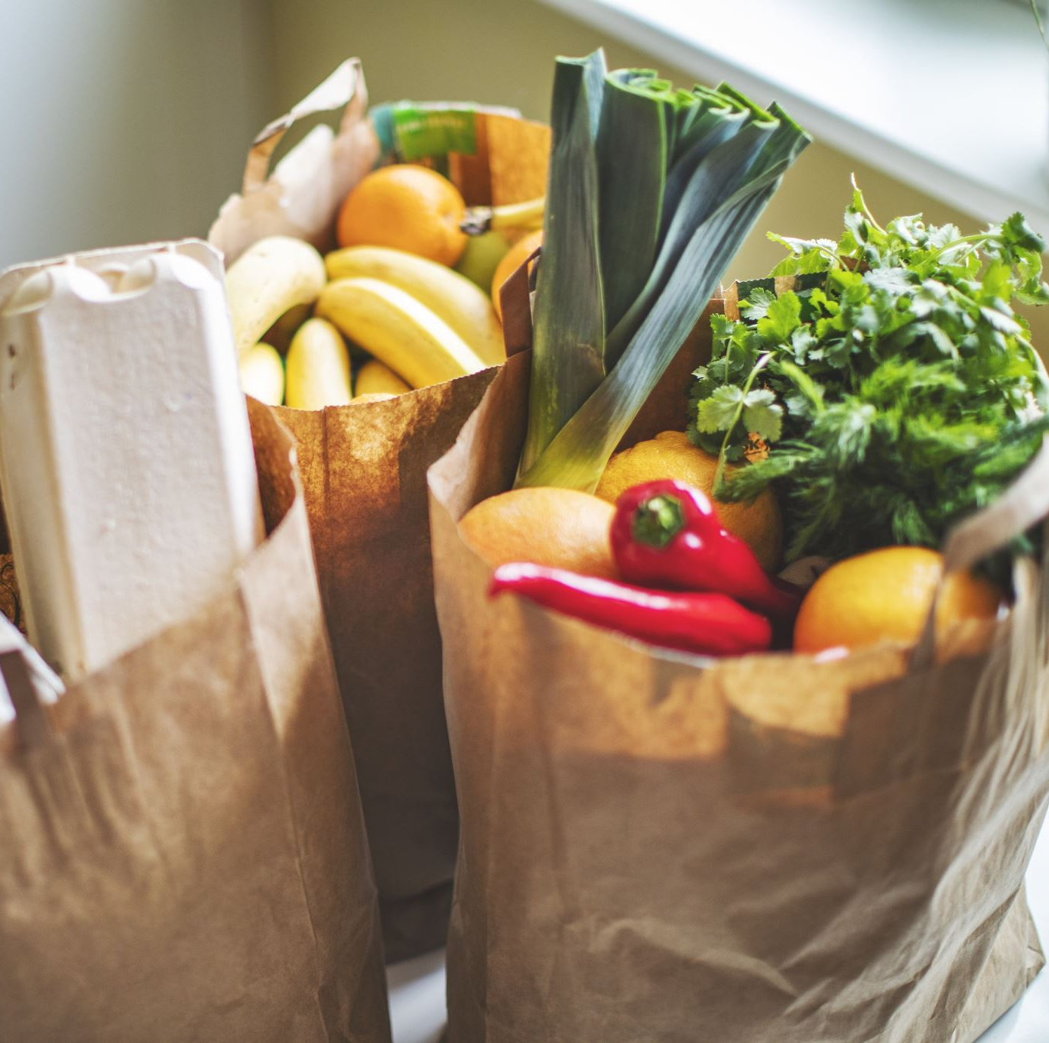
Problem Statement
A grocery store shared the transactional data with you. Your job is to conduct a thorough analysis of Point of Sale (POS) data, identify the most commonly occurring sets of items in the customer orders, and provide recommendations through which a grocery store can increase its revenue by popular combo offers & discounts for customers.

Slide 6

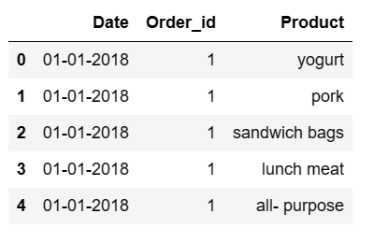
Data Head:

Slide 7
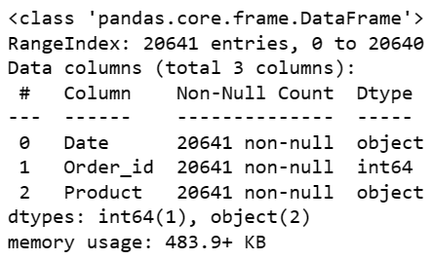
Data Info:

Slide 8
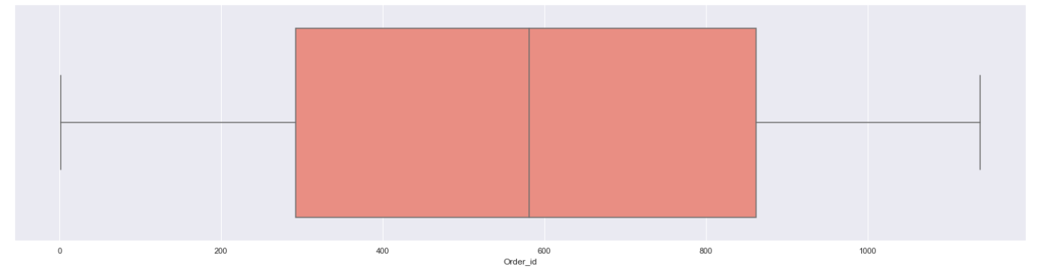
Outliers
As order_id and date don’t have any extreme value so we don’t have any outliers

Slide 9
Assumptions:
The dataset comprises a record of items bought at a grocery store across different dates.
Each record corresponds to a singular purchased item.
The initial column denotes the purchase date for each item.
The second column identifies the purchasing customer.
The third column denotes the specific item bought.
An item can be bought by multiple customers on separate dates.
The dataset lacks details regarding item quantity or price.
Duplicated values within the dataset have not been removed

Slide 10
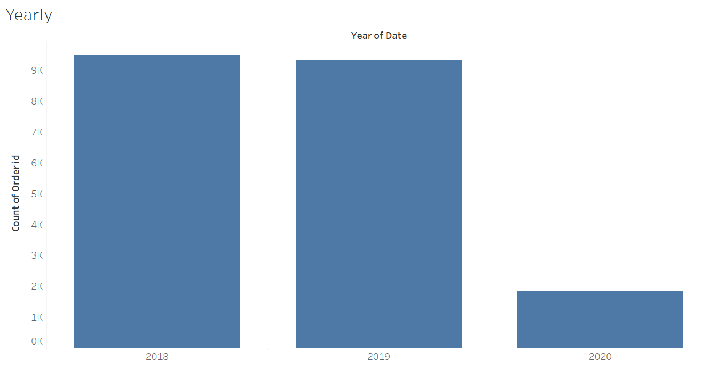
Yearly Count of Products Sold
As we have data till 26 feb 2020 that’s why the count of products sold in 2020 is low.

Slide 11
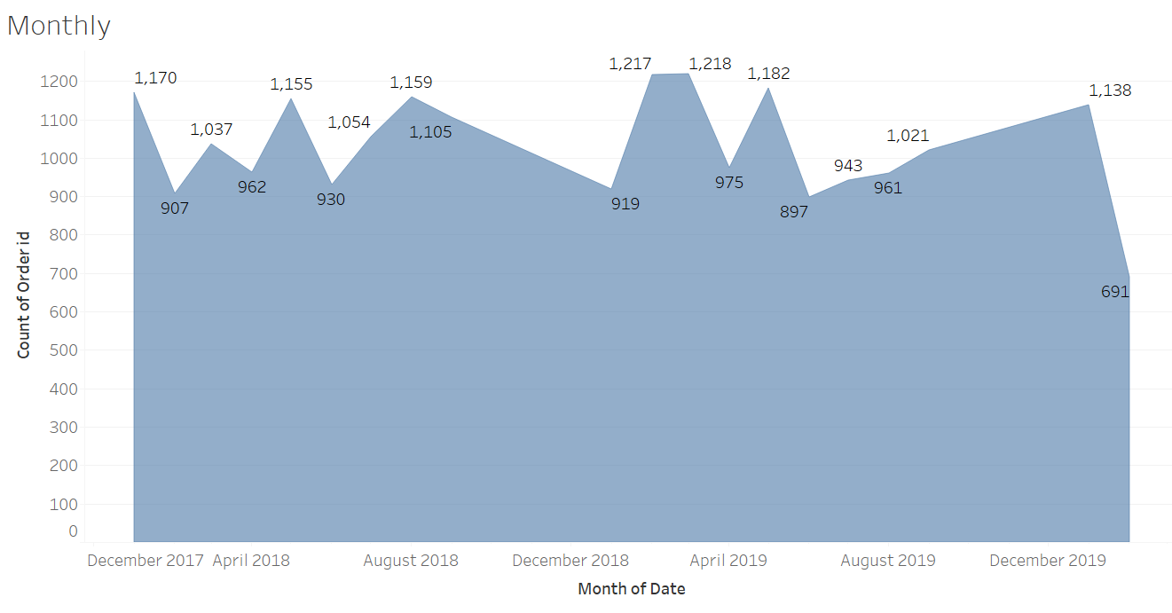
Monthly Count of Products Sold
We can see the trend that Products sales increases at the end of the year in December

Slide 12
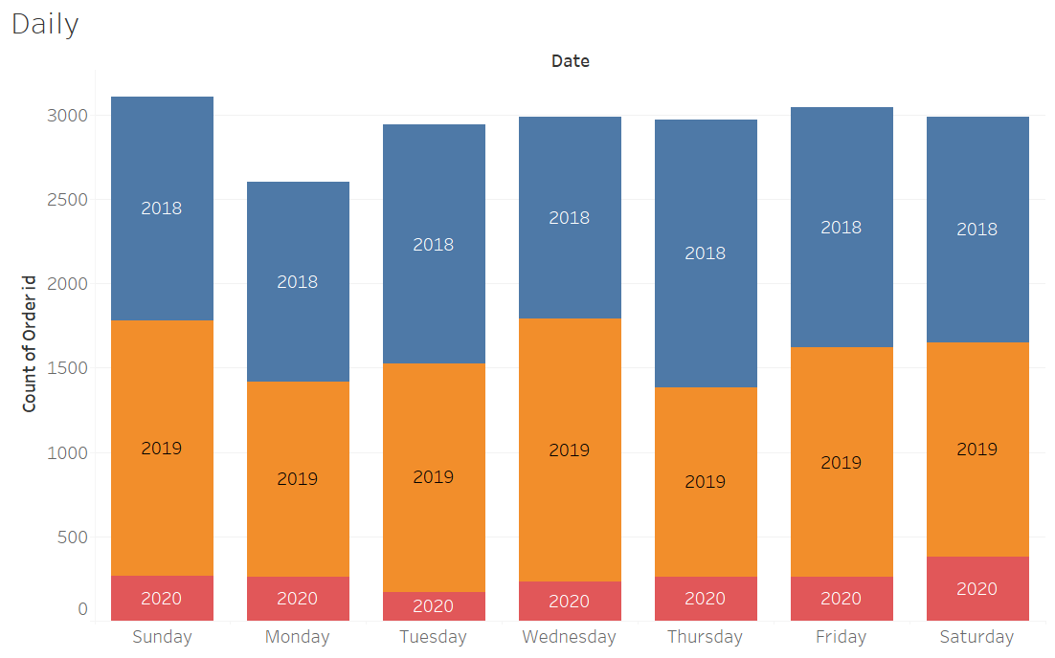
Weekly Count of Products Sold
Count of orders are highest on Sunday and lowest on Monday.
For the rest of the days of weeks the count of order is consistent.

Slide 13
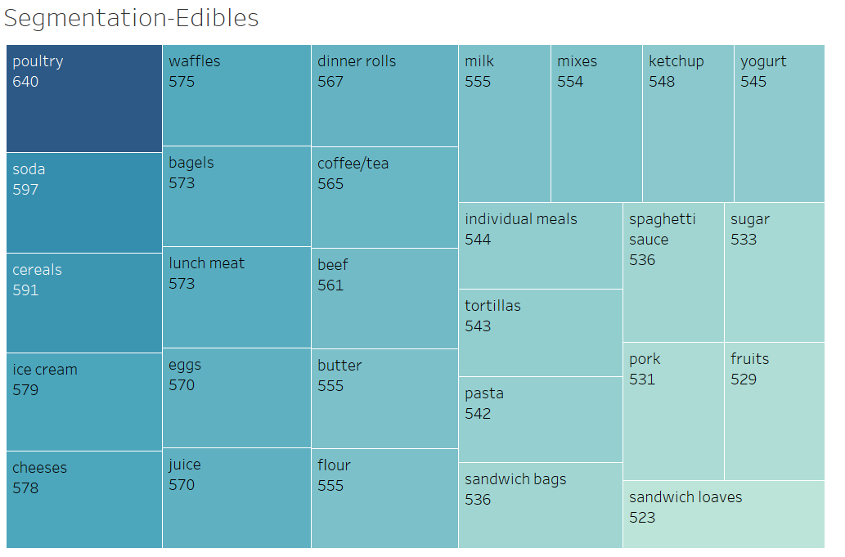
Count of Edibles Products Sold
There is not much variation in count for different edible items.
The most bought edible item is poultry.

Slide 14
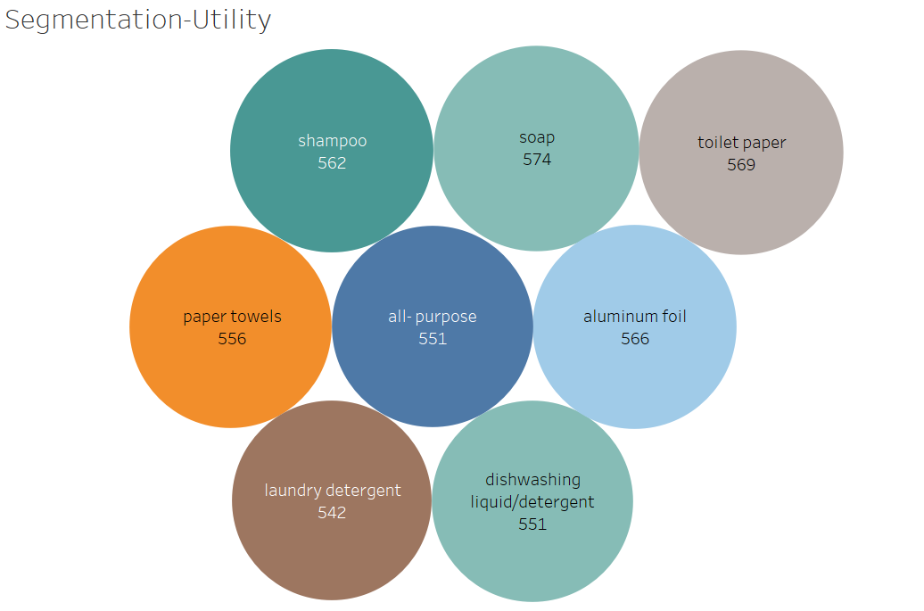
Count of Utility Products Sold
There is no variation in the sales for the items.

Slide 15
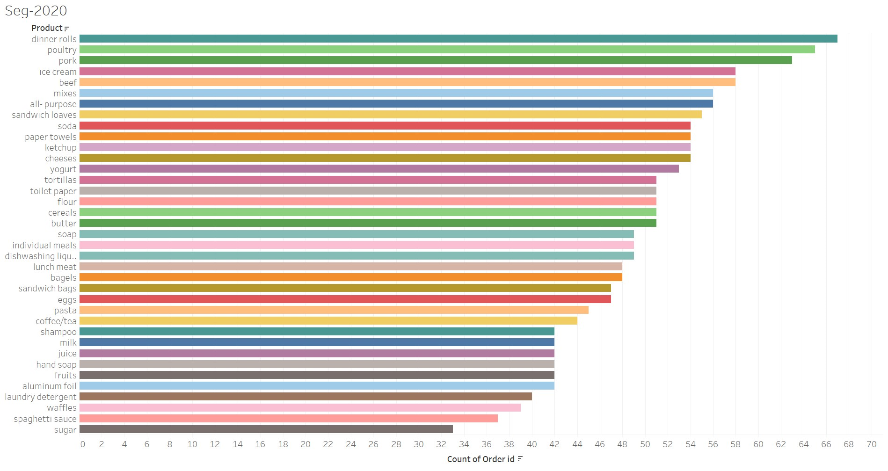
Count of Products Sold Yearly

Slide 16
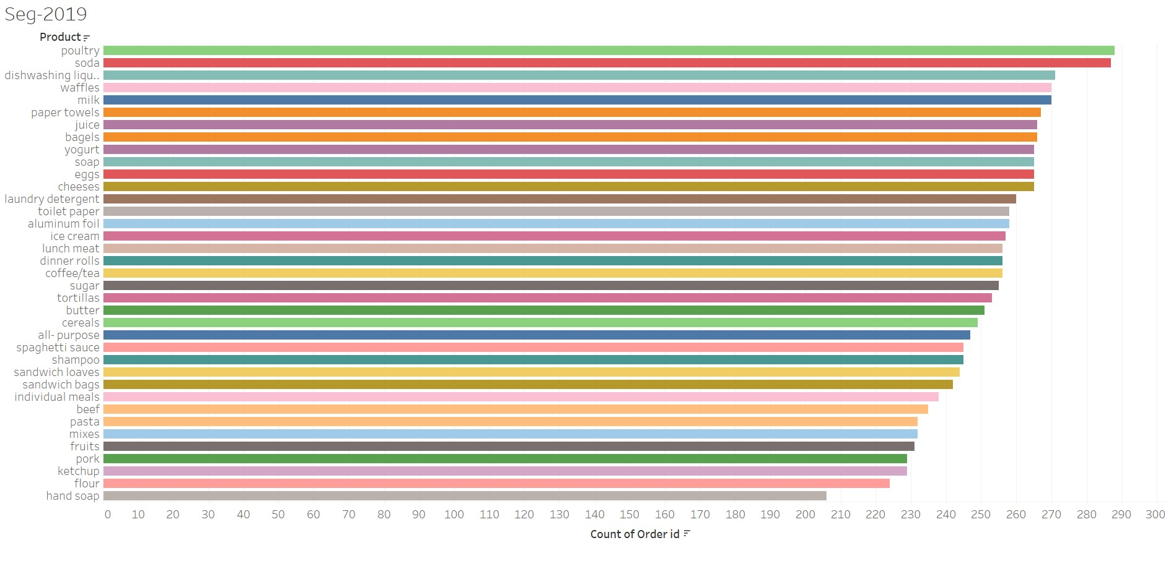
Count of Products Sold Yearly

Slide 17
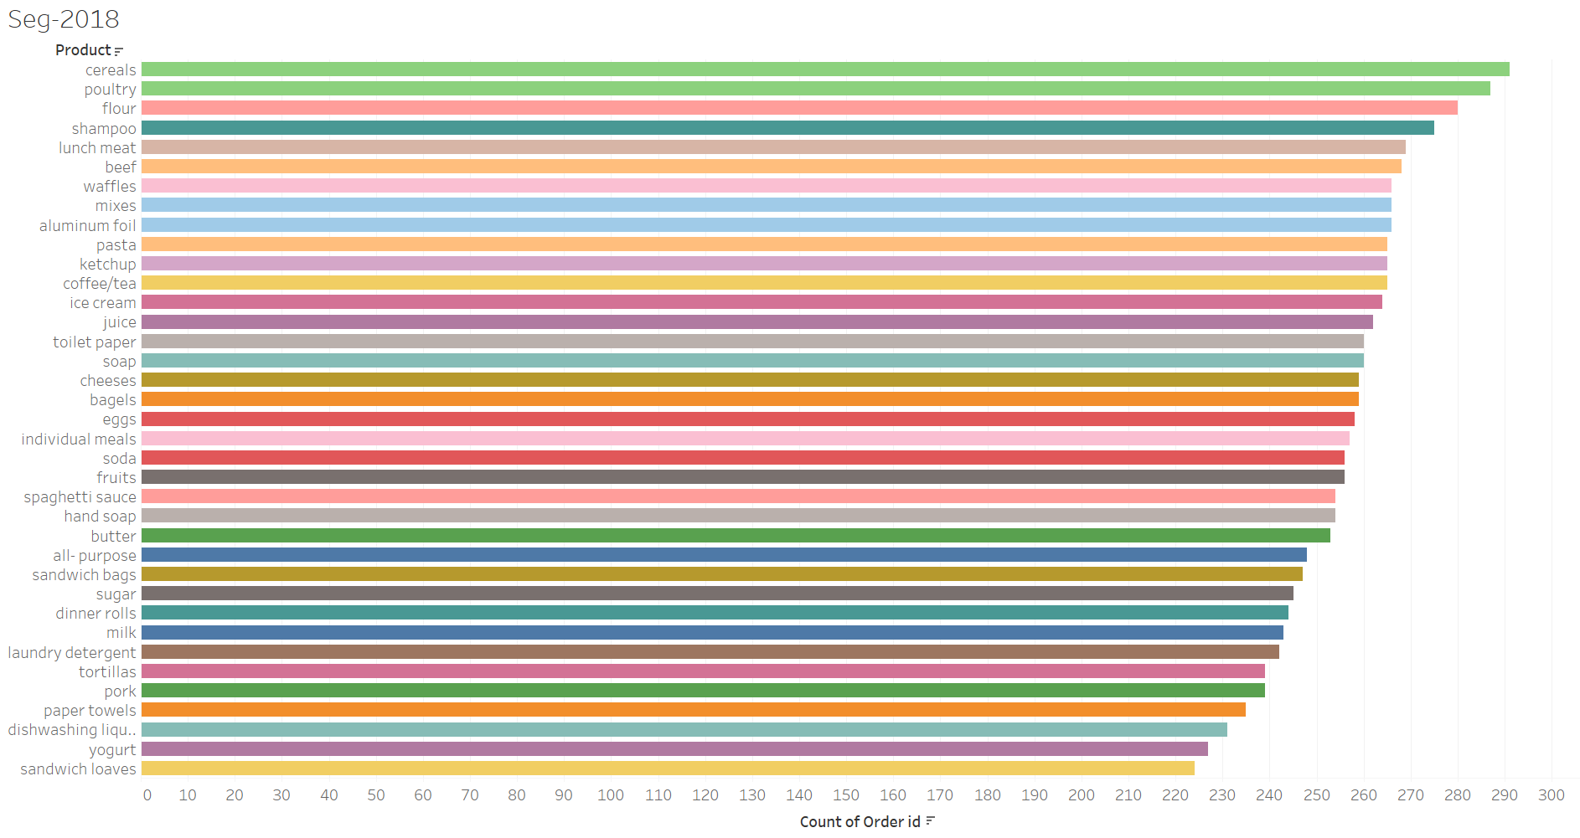
Count of Products Sold Yearly

Slide 18
Summary
The top three best-selling products in both 2018 and 2019 were Cereals, Poultry, and Soda.
The leading products in January and February 2020 were Dinner rolls, Poultry, and Pork.
Over the years, Poultry, Cereals, and Soda emerged as the most highly sold products.
Among non-edible items, Soap and Toilet Paper recorded the highest sales, while Hand Soap had the lowest sales.
Within the edible category, the highest-selling items included Poultry, Soda, and Cereals. In contrast, the least sold items were Pork, Fruits, and Sandwich Loaves.
Sundays marked the peak of sales activity, whereas Mondays saw the lowest sales figures.
Sales reached their peak in January 2018, but February 2018 had the lowest sales. Similarly, March 2019 marked the highest sales, while January 2019 had the lowest.
The highest sales were recorded in the first quarter of 2019 and the third quarter of 2018.
The sales volume during the second quarter remained relatively consistent between 2019 and 2018.
The lower sales count in 2020 could be attributed to the fact that the data only extends until February 26th.

Slide 19
Recommendation:
Emphasize the promotion and availability of poultry, soda, and cereals, given their consistent top-selling performance.
Consider augmenting the inventory of soap and toilet paper, as these non-edible products have consistently demonstrated the highest sales figures.
Investigate the factors contributing to the subdued sales of hand soap and implement strategies to boost its sales.
Strategize promotions and special offers specifically for Sundays to capitalize on the day with the highest sales activity.
Develop targeted marketing campaigns and offer incentives during February to counter historically lower sales during this month.
Develop comprehensive marketing strategies and attractive discounts for both January and March to capitalize on the historically strong sales months.
Aim to replicate the sales patterns observed in Q1 2019 and Q3 2018, focusing on their successful strategies.
Maintain a consistent inventory of products in Q2 to align with previous years' sales patterns and sustain sales performance.
Make informed sales and marketing decisions while keeping in mind the limited data available for 2020.

Slide 20
Market Basket Analysis
Market Basket Analysis Definition: A statistical technique uncovering links between products in customer purchases, guiding businesses in understanding buying patterns' impact on sales.
Data: Transactional data containing customer and product IDs is crucial. It's used to create a matrix showing product relationships.
Association Rules: These quantify relationships between products using support, confidence, and lift, measuring co-occurrence frequency, purchase likelihood, and correlation.
Applications: Widely used in retail, e-commerce, and marketing, it optimizes product placement, personalizes recommendations, and refines advertising campaigns.
Benefits: Boosts revenue by identifying cross-selling opportunities, shapes promotions, and enhances customer satisfaction through personalized experiences.

Slide 21
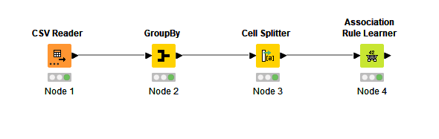
MRA KNIME Workflow

Slide 22
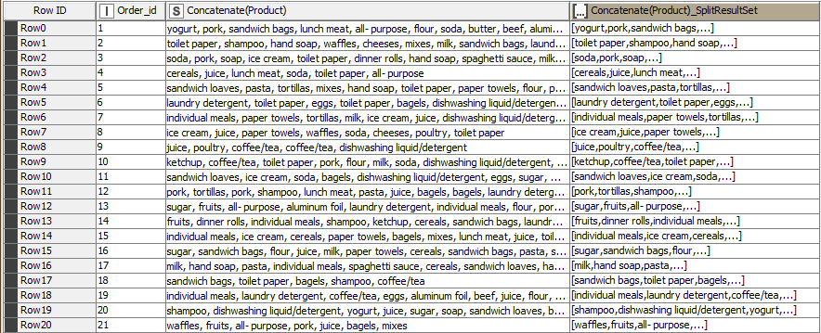
Output Table

Slide 23
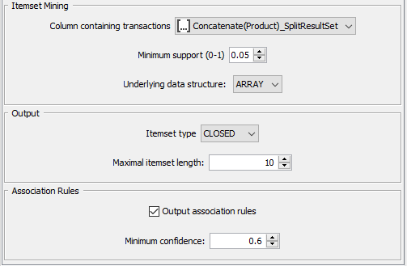
Association Rule Parameters
Support of Minimum: 0.05
Maximum Item Set Length : 10
Minimum Confidence Level:0.6

Slide 24
Market basket analysis, support, confidence, and lift values
Within market basket analysis, the metrics of support, confidence, and lift quantify the strength of associations between items within a transaction dataset.
Support: This denotes the likelihood of items co-occurring in a transaction. It's calculated by dividing the number of transactions containing both items by the total transactions. High support signals frequent itemset occurrence, suggesting items suitable for joint promotion or placement.
Confidence: This reflects the likelihood that one item appears in a transaction when another is present. Calculated by dividing the number of transactions containing both items by the number with the first item, it gauges the association strength. High confidence suggests items often bought together, useful for suggesting or recommending items.
Lift: This quantifies how much more often two items appear together compared to what's expected if they were independent. Computed as the itemset's support divided by the product of individual item supports, a lift of 1 implies independence. Lift above 1 indicates a positive association, while below 1 indicates a negative one. Elevated lift indicates robust association, useful for cross-selling or bundling strategies.

Slide 25
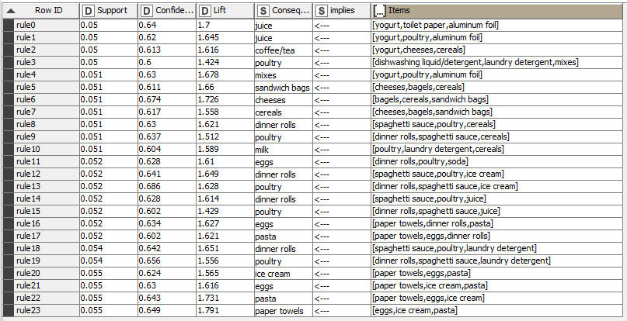
Association Rules
Association rules serve as a method to uncover connections among items within extensive datasets. These rules stem from frequent itemsets, which encompass items frequently appearing together in transactional datasets.
A total of 24 rules have been identified within the dataset, established with predefined parameters.

Slide 26
Recommendations:
Introduce a "Buy Two Get One Free" promotion for yogurt, poultry, and aluminum foil to incentivize customers to make larger purchases.
Develop a bundled deal allowing customers to buy cereals, bagels, and sandwich bags together at a reduced rate.
Offer discounted rates on mixes when they are purchased alongside yogurt, poultry, or aluminum foil.
Extend discounts on dinner rolls when bought with spaghetti sauce or poultry.
Craft a comprehensive "Paper Products Bundle" featuring paper towels, toilet paper, and/or tissues, available at a discounted price
These strategic discounts and combo deals can effectively elevate sales by enhancing the value customers get for their spending and motivating them to explore additional purchases. Ensuring the visibility of these offers through in-store signage, advertisements, and social media is key to maximizing customer awareness and participation.

Slide 27
Summary
Through the analysis, the store has identified frequently paired products in customer purchases. This insight can enhance the store's strategies for product arrangement and promotional efforts.
Notable products frequently bought together include yogurt, poultry, aluminum foil, cheeses, cereals, and dinner rolls.
The analysis uncovers intriguing associations, such as poultry's connection with dishwashing liquid/detergent, laundry detergent, and mixes.
The analysis indicates that implementing discounts or combo deals, like "buy two get one free," for specific products could stimulate customers to buy more.
Additionally, strategically situating complementary products nearby can augment the likelihood of supplementary purchases.
Altogether, the market basket analysis furnishes valuable comprehension of customer preferences and behaviors, facilitating informed decisions regarding both product positioning and promotional strategies for the store.

Slide 28

Thank You

